Slide 1
Module 3

Slide 2
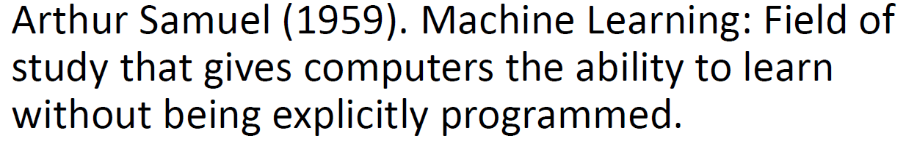
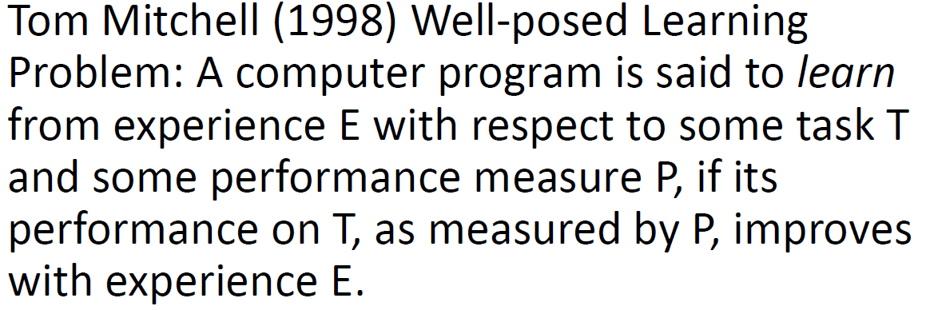

Definition
Andrew Ng - Coursera

Slide 3
SPAM CLASSIFICATION (T)
T
E
Machine learning model
SPAM
FEATURES
NOT SPAM
P
Performance
Measures
Accuracy, Precision, Recall

Slide 4
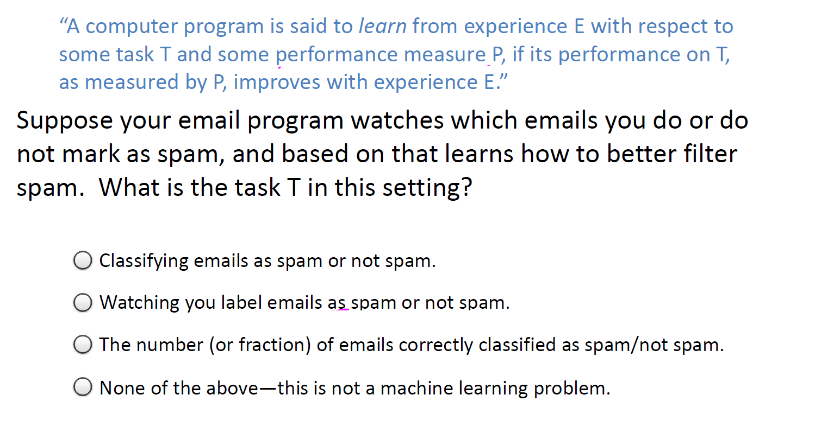
Example
Andrew Ng - Coursera

Slide 5
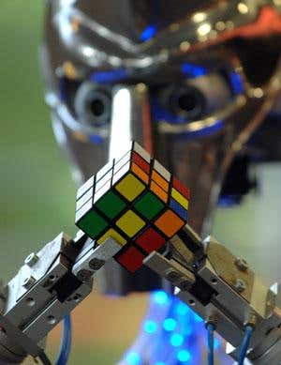
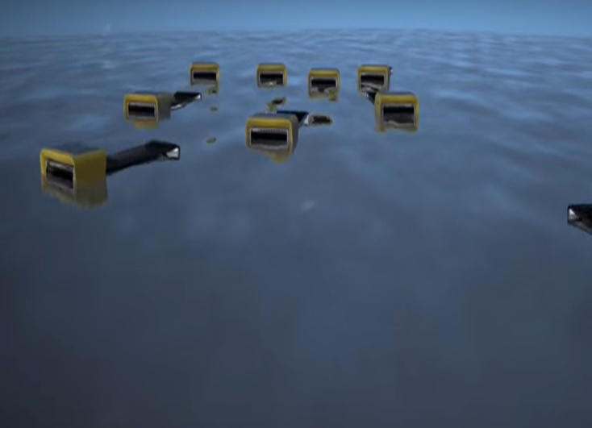
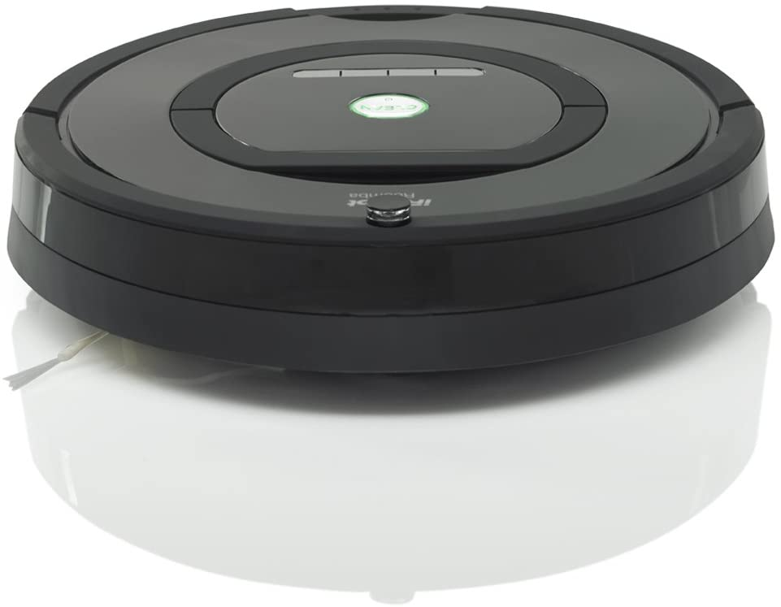


Applications
iRobot Roomba in-home Robotic Vacuum Cleaner
RuBot II or The Cubinator
http://senseable.mit.edu/seaswarm/
Seaswarm
MOXIE
*Embodied (Social robotics
start-up company)

Slide 6
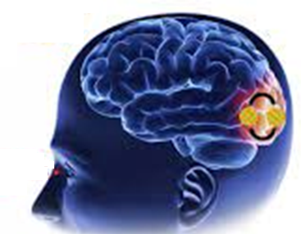

How learning happens??
Siblings, friends relatives and others
Books
Multimedia
Own perception
Teachers
A Lot more……
Parents

Slide 7
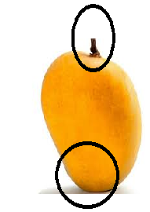
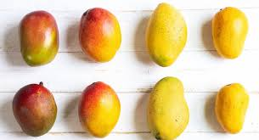
Learning in Humans
Mango
Key points
Colour
Shape
Testing

Slide 8
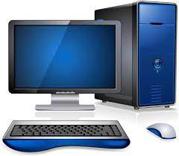
Machine Learning
Key points
Colour
With or without targets
Keypoint Descriptors, Shape and boundary descriptors, Texture descriptors, etc….
Training
Shape
Machine Learning Algortihms
Testing
Colour, Shape, Keypoint Descriptors, Shape and boundary descriptors, Texture descriptors, etc….
Mango

Slide 9

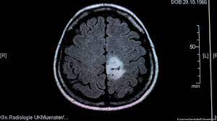
Features
Built in area | Distance from the city | Amenities | Price
Height | Price | Wheels (No.) | Size | Model
Fever | Throat pain | Cough | Body pain | Covid (Y/N)
Size, Thickness, Region
Statistical Attributes

Slide 10
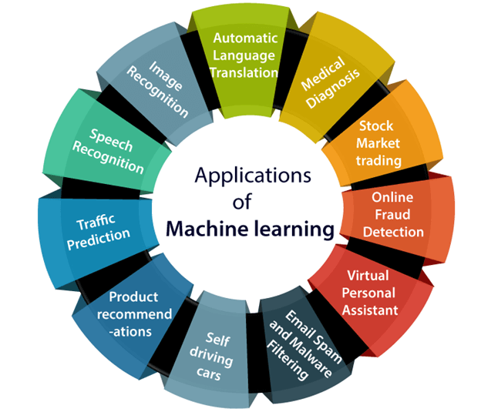
Applications
https://www.javatpoint.com/applications-of-machine-learning

Slide 11
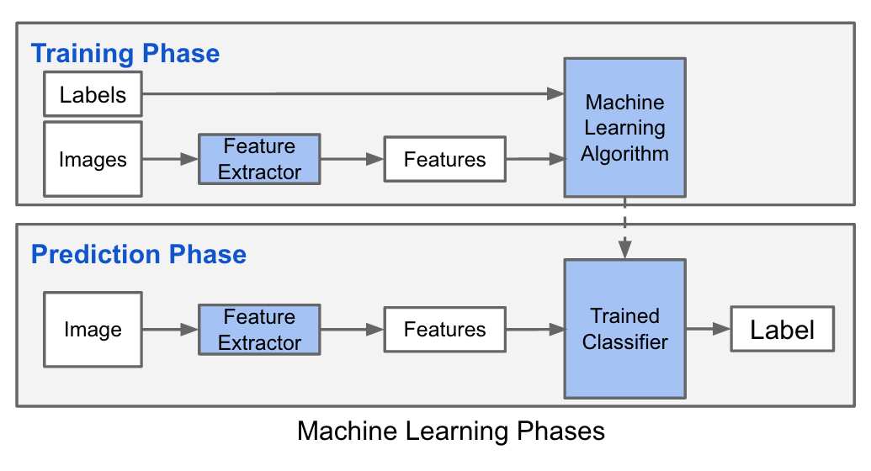
Machine Learning Flow
https://datascience.stackexchange.com/questions/16422/machine-learning-vs-deep-learning

Slide 12
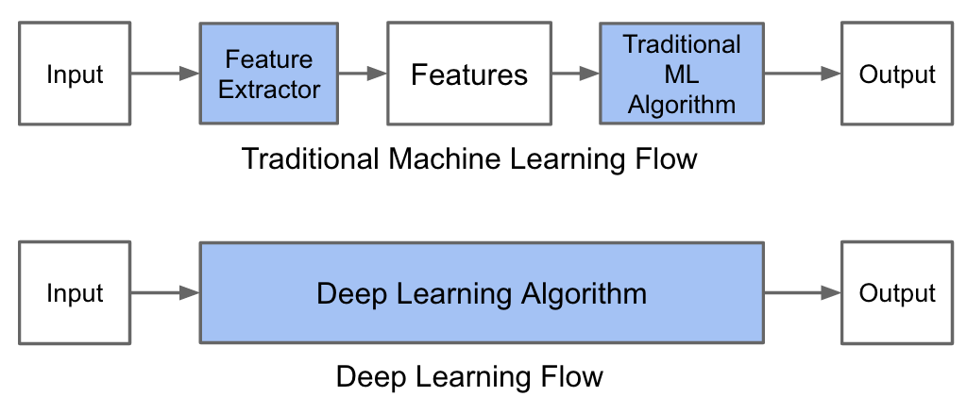
Machine Learning Flow Vs Deep Learning Flow
https://datascience.stackexchange.com/questions/16422/machine-learning-vs-deep-learning

Slide 13
Research in Literature

Slide 14
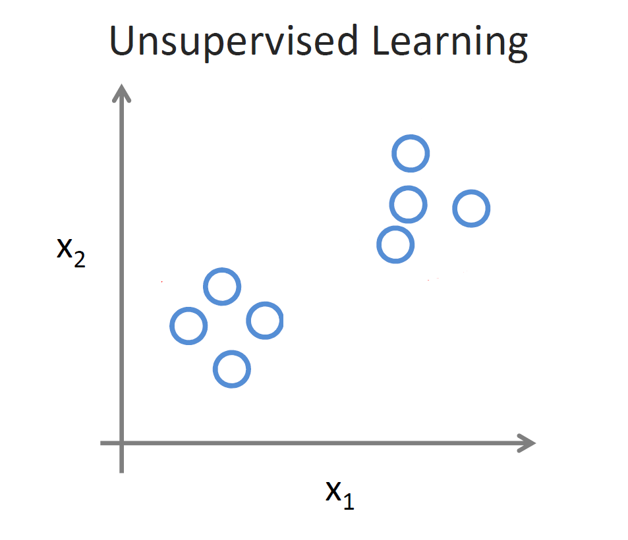
Types of Learning
Supervised Learning
Unsupervised Learning
Reinforcement Learning

Slide 15
Supervised Learning
Basically supervised learning is when we teach or train the machine using data that is well labeled. Which means some data is already tagged with the correct answer. After that, the machine is provided with a new set of examples(data) so that the supervised learning algorithm analyses the training data and produces a correct outcome from labeled data.
Supervised learning classified into two categories of algorithms:
Classification: A classification problem is when the output variable is a category, such as “Red” or “blue” or “disease” and “no disease”.
Regression: A regression problem is when the output variable is a real value, such as “dollars” or “weight”.
Types:-
Regression
Logistic Regression
Classification
Naive Bayes Classifiers
K-NN (k nearest neighbors)
Decision Trees
Support Vector Machine
Advantages:-
Supervised learning allows collecting data and produces data output from previous experiences.
Helps to optimize performance criteria with the help of experience.

Slide 16
Supervised Learning Classification
Example: Cancer diagnosis
Training Set
Use this training set to learn how to classify patients where diagnosis is not known:
Test Set
Input Data
Classification
The input data is often easily obtained, whereas the classification is not.

Slide 17
Training Set: Usually, the majority of the data, around 60-80%, is allocated to the training set. The larger the training set, the more data the model has to learn from, which can lead to better performance given sufficient computational resources.
Validation Set: Typically, around 10-20% of the data is allocated to the validation set. This subset is used for tuning hyperparameters and model selection.
Test Set: The remaining portion of the data, around 10-20%, is reserved for the test set. It's crucial to ensure that the test set is representative of the data distribution and hasn't been used in any way during model development to obtain unbiased evaluation metrics.

Slide 18
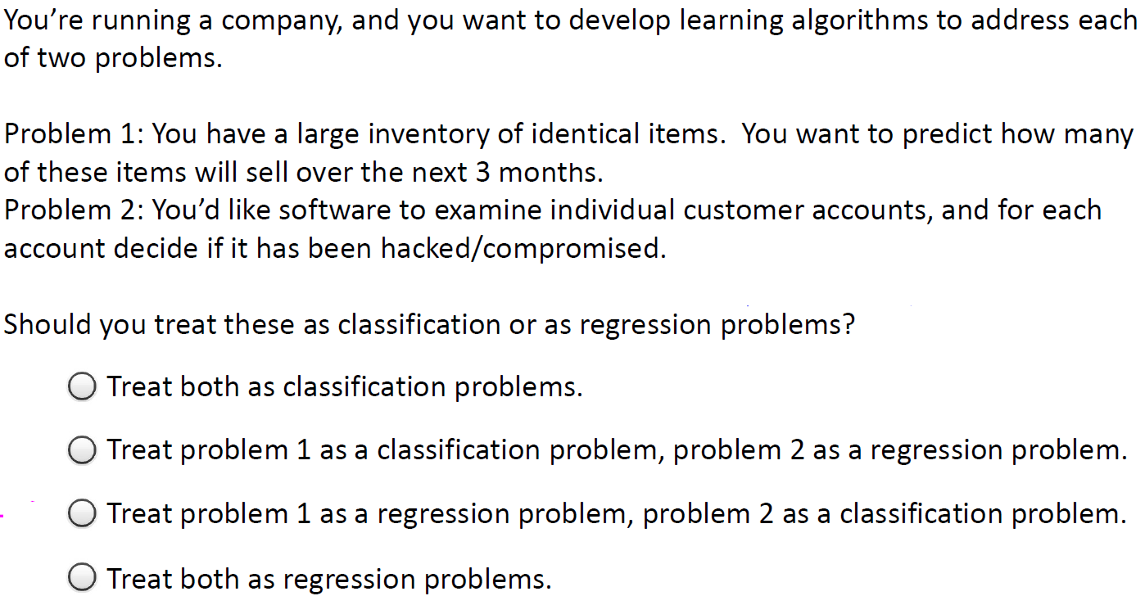
Example
Andrew Ng - Coursera

Slide 19
Unsupervised Learning
Unsupervised learning is the training of a machine using information that is neither classified nor labeled and allowing the algorithm to act on that information without guidance.
Andrew Ng - Coursera

Slide 20
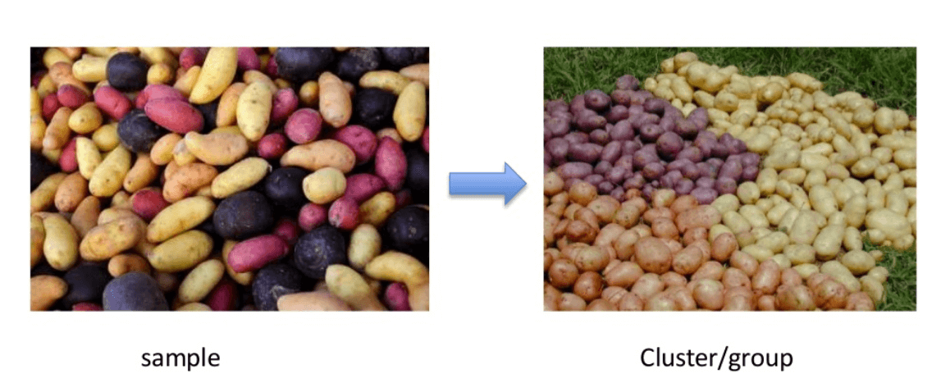
Clustering: A clustering problem is where you want to discover the inherent groupings in the data, such as grouping customers by purchasing behavior.
Association: An association rule learning problem is where you want to discover rules that describe large portions of your data, such as people that buy X also tend to buy Y.

Slide 21
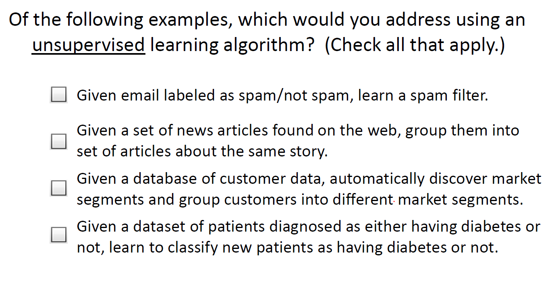
Example
Andrew Ng - Coursera

Slide 22
Performance Estimation of a Classifier
Predictive accuracy works fine, when the classes are balanced
That is, every class in the data set are equally important
In fact, data sets with imbalanced class distributions are quite common in many real life applications
When the classifier classified a test data set with imbalanced class distributions then, predictive accuracy on its own is not a reliable indicator of a classifier’s effectiveness.
Example 11.3: Effectiveness of Predictive Accuracy
Given a data set of stock markets, we are to classify them as “good” and “worst”. Suppose, in the data set, out of 100 entries, 98 belong to “good” class and only 2 are in “worst” class.
With this data set, if classifier’s predictive accuracy is 0.98, a very high value!
Here, there is a high chance that 2 “worst” stock markets may incorrectly be classified as “good”
On the other hand, if the predictive accuracy is 0.02, then none of the stock markets may be classified as “good”

Slide 23
Performance Estimation of a Classifier
Thus, when the classifier classified a test data set with imbalanced class distributions, then predictive accuracy on its own is not a reliable indicator of a classifier’s effectiveness.
This necessitates an alternative metrics to judge the classifier.
Before exploring them, we introduce the concept of Confusion matrix.

Slide 24
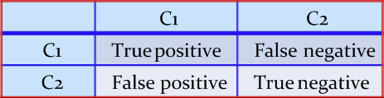
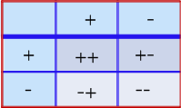
Performance Measures
A confusion matrix for a two classes (+, -) is shown below.
There are four quadrants in the confusion matrix, which are symbolized as below.
True Positive (TP: f₊₊) : The number of instances that were positive (+) and correctly classified as positive (+v).
False Negative (FN: f₊₋): The number of instances that were positive (+) and incorrectly classified as negative (-). It is also known as Type 2 Error.
False Positive (FP: f₋₊): The number of instances that were negative (-) and incorrectly classified as (+). This also known as Type 1 Error.
True Negative (TN: f₋₋): The number of instances that were negative (-) and correctly classified as (-).
Dr. Debasis Samanta

Slide 25
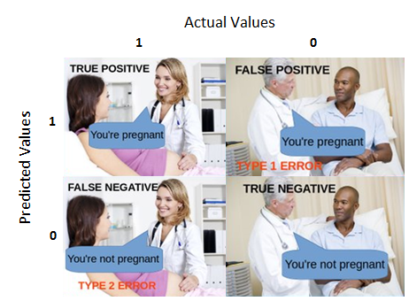

Slide 26
Confusion Matrix
Note:
N_{p} = TP (f₊₊) + FN (f₊₋)
= is the total number of positive instances.
N_{n} = FP(f₋₊) + TN(f₋₋)
= is the total number of negative instances.
N = N_{p} + N_{n}
= is the total number of instances.
(TP + TN) denotes the number of correct classification
(FP + FN) denotes the number of errors in classification.
For a perfect classifier FP = FN = 0, that is, there would be no Type 1 or Type 2 errors.

Slide 27
Confusion Matrix
Example: Confusion matrix
A classifier is built on a dataset regarding Good and Worst classes of stock markets. The model is then tested with a test set of 10000 unseen instances. The result is shown in the form of a confusion matrix. The result is self explanatory.
Class | Good | Worst | Total | Rate(%)
Good | 6954 | 46 | 7000 | 99.34
Worst | 412 | 2588 | 3000 | 86.27
Total | 7366 | 2634 | 10000 | 95.52
Predictive accuracy?

Slide 28
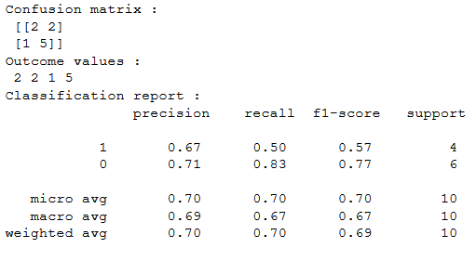
Numerical Example

Slide 29
Solution

Slide 30
Confusion Matrix for Multiclass Classifier
Having m classes, confusion matrix is a table of size m×m , where, element at (i, j) indicates the number of instances of class i but classified as class j.
To have good accuracy for a classifier, ideally most diagonal entries should have large values with the rest of entries being close to zero.
Confusion matrix may have additional rows or columns to provide total or recognition rates per class.

Slide 31
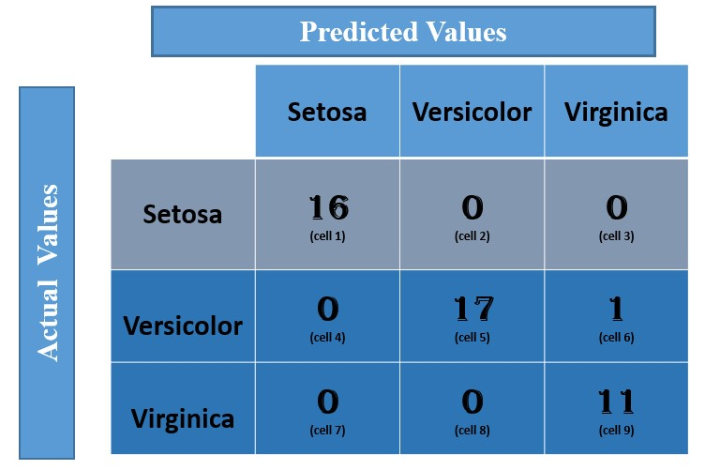
Confusion Matrix for Multiclass Classifier
Example: Confusion matrix with multiple class (Iris dataset)
Following table shows the confusion matrix of a classification problem with three classes.
Predictive accuracy?

Slide 32
Solution
2
24

Slide 33
Confusion Matrix for Multiclass Classifier
Example 1: Confusion matrix with multiple class
Following table shows the confusion matrix of a classification problem with six classes labeled as C₁, C₂, C₃, C₄, C₅ and C₆.
Class | C1 | C2 | C3 | C4 | C5 | C₆
C1 | 52 | 10 | 7 | 0 | 0 | 1
C2 | 15 | 50 | 6 | 2 | 1 | 2
C3 | 5 | 6 | 6 | 0 | 0 | 0
C4 | 0 | 2 | 0 | 10 | 0 | 1
C5 | 0 | 1 | 0 | 0 | 7 | 1
C₆ | 1 | 3 | 0 | 1 | 0 | 24
Predictive accuracy?

Slide 34
Confusion Matrix for Multiclass Classifier
In case of multiclass classification, sometimes one class is important enough to be regarded as positive with all other classes combined together as negative.
Thus a large confusion matrix of m*m can be resized into 2*2 matrix.
Example 2: m×m CM to 2×2 CM
For example, the CM shown in Example 1 is transformed into a CM of size 2×2 considering the class C₁ as the positive class and classes C₂, C₃, C₄, C₅ and C₆ combined together as negative.
How we can calculate the predictive accuracy of the classifier model in this case?
Are the predictive accuracy same in both Example 1 and Example 2?
Class | + | -
+ | 52 | 18
- | 21 | 123

Slide 35
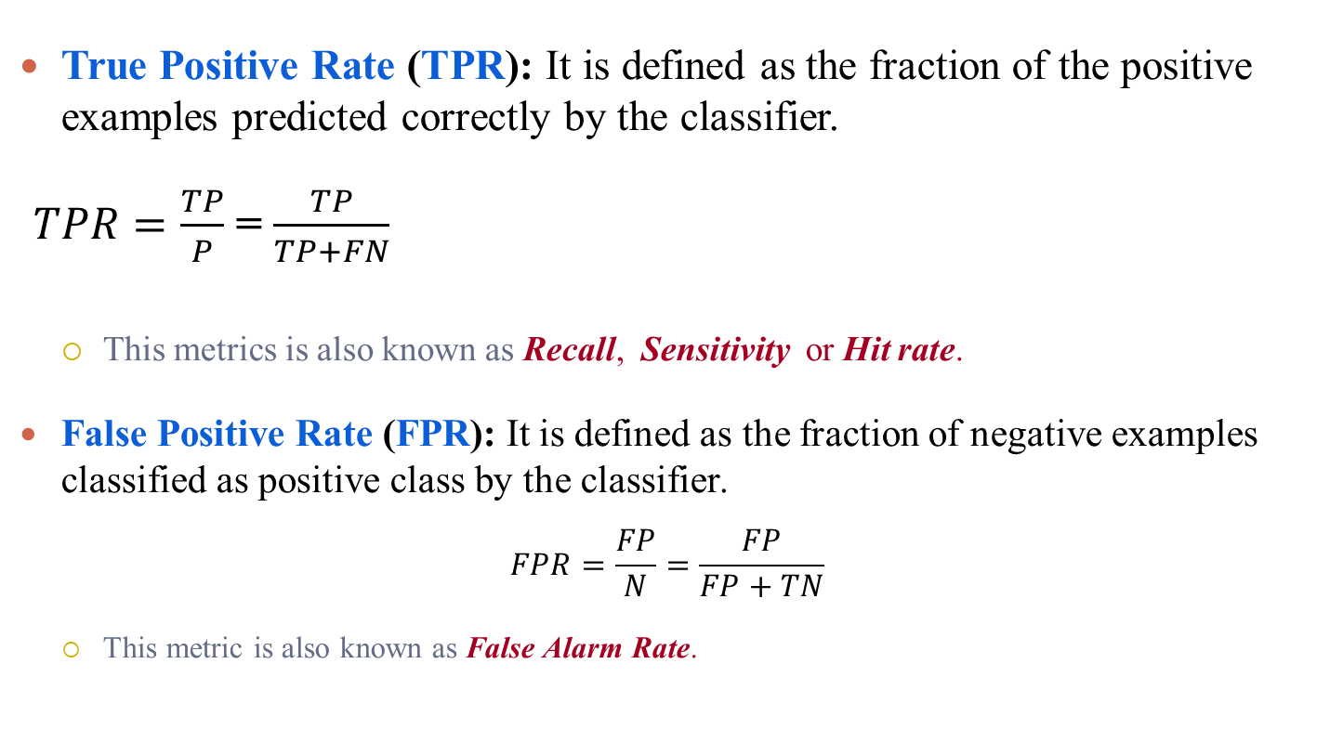
Recall, Sensitivity and False Alarm Rate
True Positive Rate (TPR): It is defined as the fraction of the positive examples predicted correctly by the classifier.
$TPR=\frac{TP}{P}$ = $\frac{TP}{TP+FN}$
This metrics is also known as Recall, Sensitivity or Hit rate.
False Positive Rate (FPR): It is defined as the fraction of negative examples classified as positive class by the classifier.
$$FPR=\frac{FP}{N}=\frac{FP}{FP+TN}$$
This metric is also known as False Alarm Rate.
Dr. Debasis Samanta

Slide 36
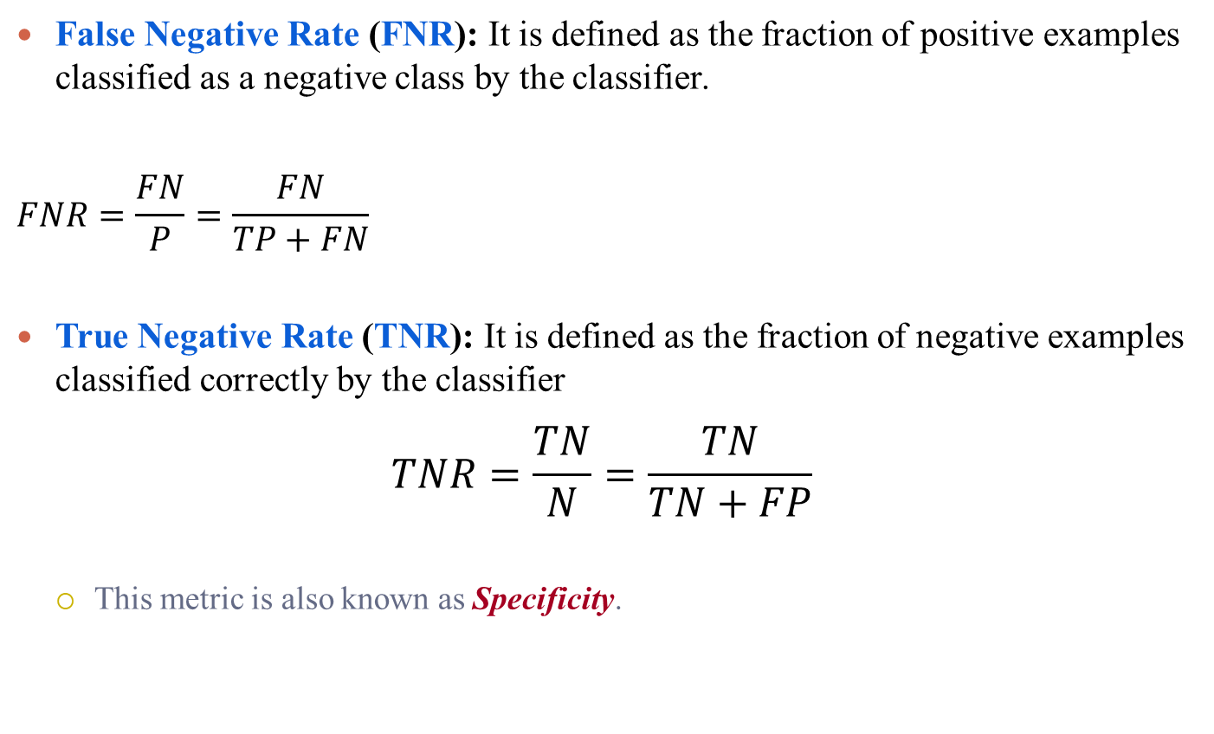
Specificity
False Negative Rate (FNR): It is defined as the fraction of positive examples classified as a negative class by the classifier.
$$FNR=\frac{FN}{P}=\frac{FN}{TP+FN}$$
True Negative Rate (TNR): It is defined as the fraction of negative examples classified correctly by the classifier
$$TNR=\frac{TN}{N}=\frac{TN}{TN+FP}$$
This metric is also known as Specificity.
Dr. Debasis Samanta

Slide 37
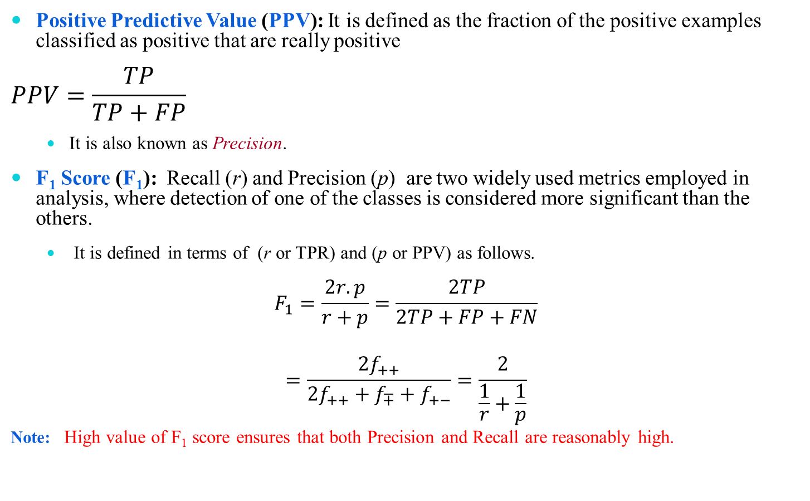
Precision, F1 Score
Positive Predictive Value (PPV): It is defined as the fraction of the positive examples classified as positive that are really positive
$$PPV=\frac{TP}{TP+FP}$$
It is also known as Precision.
F₁ Score (F₁): Recall (r) and Precision (p) are two widely used metrics employed in analysis, where detection of one of the classes is considered more significant than the others.
It is defined in terms of (r or TPR) and (p or PPV) as follows.
$$F_{1}=\frac{2r.p}{r+p}=\frac{2TP}{2TP+FP+FN}$$
$$=\frac{{2f}_{++}}{{2f}_{++}+f_{∓}+f_{+−}}=\frac{2}{\frac{1}{r}+\frac{1}{p}}$$
Note: High value of F₁ score ensures that both Precision and Recall are reasonably high.
Dr. Debasis Samanta

Slide 38
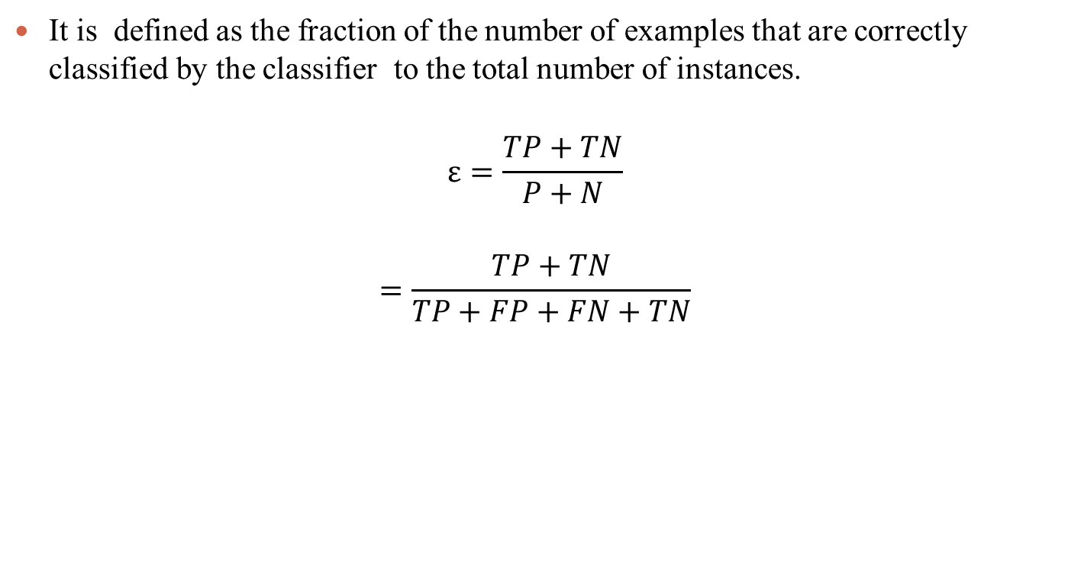
Predictive Accuracy
It is defined as the fraction of the number of examples that are correctly classified by the classifier to the total number of instances.
$$ε=\frac{TP+TN}{P+N}$$
$$=\frac{TP+TN}{TP+FP+FN+TN}$$

Slide 39
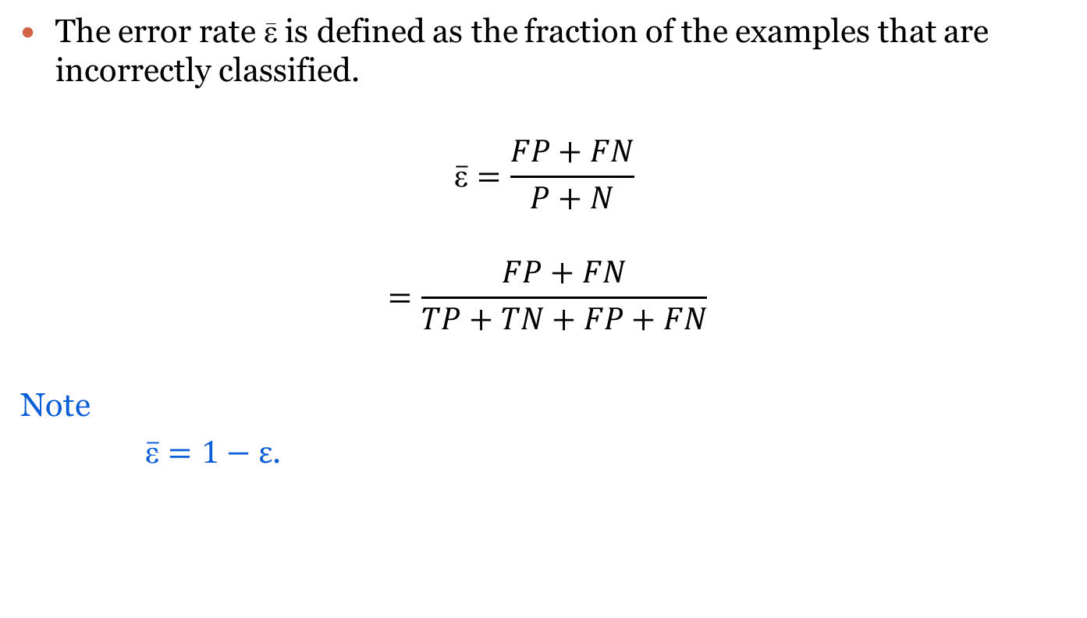
Error Rate
The error rate $\overline{\text{ε}}$ is defined as the fraction of the examples that are incorrectly classified.
$$\overline{\text{ε}}=\frac{FP+FN}{P+N}$$
$$=\frac{FP+FN}{TP+TN+FP+FN}$$
Note
$\overline{\overline{\text{ε}}}=1−ε$.
Dr. Debasis Samanta

Slide 40
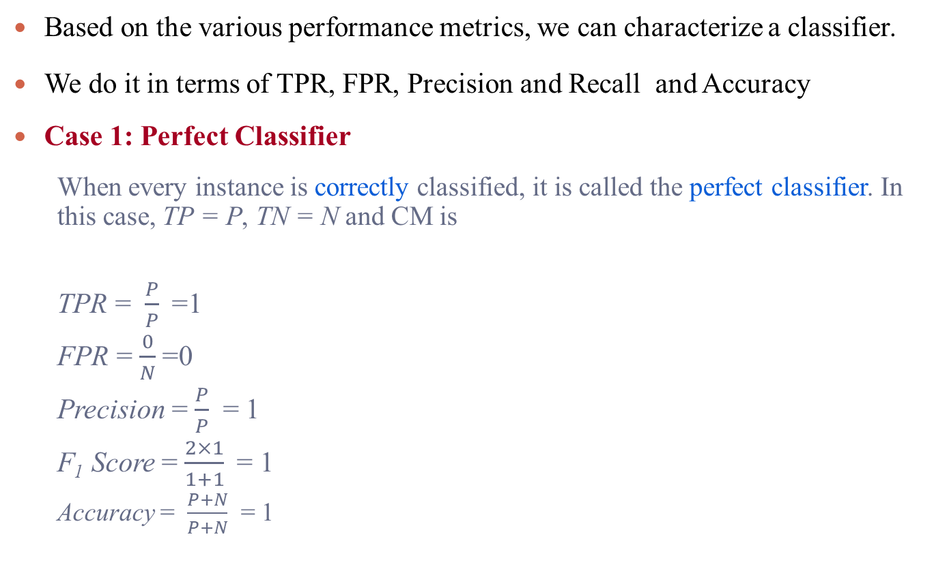
Perfect Classifier
Based on the various performance metrics, we can characterize a classifier.
We do it in terms of TPR, FPR, Precision and Recall and Accuracy
Case 1: Perfect Classifier
When every instance is correctly classified, it is called the perfect classifier. In this case, TP = P, TN = N and CM is
TPR = $\frac{P}{P}$=1
FPR = $\frac{0}{N}$=0
Precision = $\frac{P}{P}$ = 1
F₁ Score = $\frac{2×1}{1+1}$= 1
Accuracy = $\frac{P+N}{P+N}$ = 1
Dr. Debasis Samanta

Slide 41
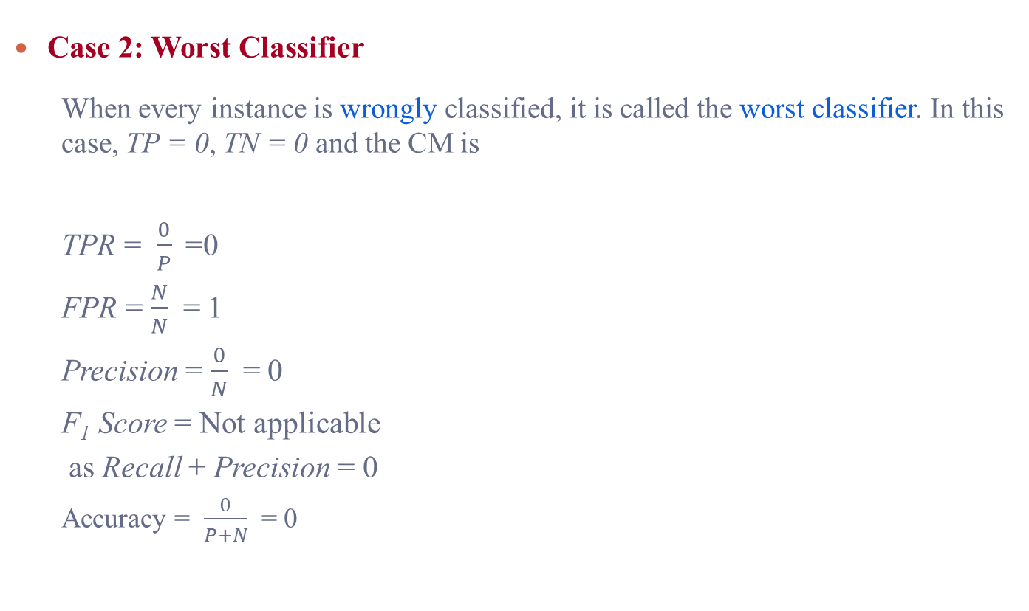
Worst Classifier
Case 2: Worst Classifier
When every instance is wrongly classified, it is called the worst classifier. In this case, TP = 0, TN = 0 and the CM is
TPR = $\frac{0}{P}$=0
FPR = $\frac{N}{N}$ = 1
Precision = $\frac{0}{N}$ = 0
F₁ Score = Not applicable
as Recall + Precision = 0
Accuracy = $\frac{0}{P+N}$ = 0
Dr. Debasis Samanta

Slide 42
ROC Curves

Slide 43
ROC Curves
ROC is an abbreviation of Receiver Operating Characteristic come from the signal detection theory, developed during World War 2 for analysis of radar images.
In the context of classifier, ROC plot is a useful tool to study the behaviour of a classifier or comparing two or more classifiers.
A ROC plot is a two-dimensional graph, where, X-axis represents FP rate (FPR) and Y-axis represents TP rate (TPR).
Since, the values of FPR and TPR varies from 0 to 1 both inclusive, the two axes thus from 0 to 1 only.
Each point (x, y) on the plot indicating that the FPR has value x and the TPR value y.

Slide 44
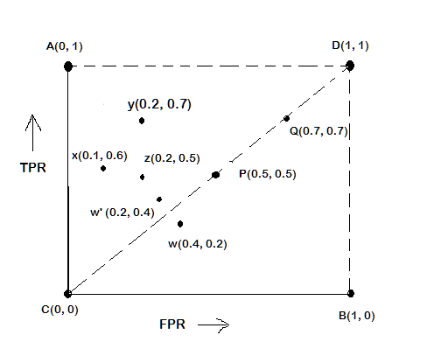
ROC Plot
A typical look of ROC plot with few points in it is shown in the following figure.
Note the four cornered points are the four extreme cases of classifiers
Identify the four extreme classifiers.

Slide 45
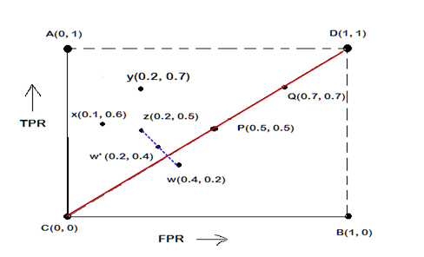
Receiver Operating Characteristics (ROC Curve)
Let us interpret the different points in the ROC plot.
The four points (A, B, C, and D)
A: TPR = 1, FPR = 0, the ideal model, i.e., the perfect classifier, no false results
B: TPR = 0, FPR = 1, the worst classifier, not able to predict a single instance
C: TPR = 0, FPR = 0, the model predicts every instance to be a Negative class, i.e., it is an ultra-conservative classifier
D: TPR = 1, FPR = 1, the model predicts every instance to be a Positive class, i.e., it is an ultra-liberal classifier
A ROC plot is a two-dimensional graph, where, X-axis represents FP rate (FPR) and Y-axis represents TP rate (TPR).
Dr. Debasis Samanta

Slide 46
Interpretation of Different Points in ROC Plot
Le us interpret the different points in the ROC plot.
The points on diagonals
The diagonal line joining point C(0,0) and D(1,1) corresponds to random guessing
Random guessing means that a record is classified as positive (or negative) with a certain probability
Suppose, a test set contacting N₊ positive and N₋ negative instances. Suppose, the classifier guesses any instances with probability p
Thus, the random classifier is expected to correctly classify p.N₊ of the positive instances and p.N₋ of the negative instances
Hence, TPR = FPR = p
Since TPR = FPR, the random classifier results reside on the main diagonals

Slide 47
Interpretation of Different Points in ROC Plot
Let us interpret the different points in the ROC plot.
The points on the upper diagonal region
All points, which reside on upper-diagonal region are corresponding to classifiers “good” as their TPR is as good as FPR (i.e., FPRs are lower than TPRs)
Here, X is better than Z as X has higher TPR and lower FPR than Z.
If we compare X and Y, neither classifier is superior to the other

Slide 48
Interpretation of Different Points in ROC Plot
Let us interpret the different points in the ROC plot.
The points on the lower diagonal region
The Lower-diagonal triangle corresponds to the classifiers that are worst than random classifiers
Note: A classifier that is worst than random guessing, simply by reversing its prediction, we can get good results.
W’(0.2, 0.4) is the better version than W(0.4, 0.2), W’ is a mirror reflection of W

Slide 49
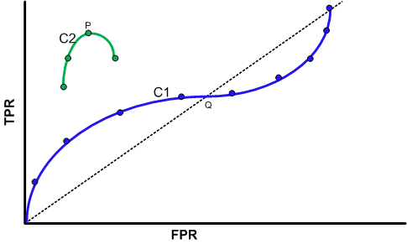
Tuning a Classifier through ROC Plot
Using ROC plot, we can compare two or more classifiers by their TPR and FPR values and this plot also depicts the trade-off between TPR and FPR of a classifier.
Examining ROC curves can give insights into the best way of tuning parameters of classifier.
For example, in the curve C2, the result is degraded after the point P. Similarly for the observation C1, beyond Q the settings are not acceptable.

Slide 50
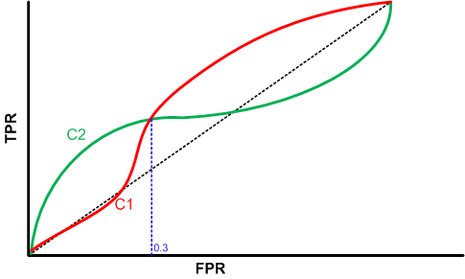
Comparing Classifiers through ROC Plot
Two curves C1 and C2 are corresponding to the experiments to choose two classifiers with their parameters.
Here, C2 is better than C1 when FPR is less than 0.3.
However, C1 is better, when FPR is greater than 0.3.
Clearly, neither of these two classifiers dominates the other.

Slide 51
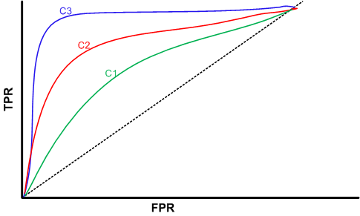
Comparing Classifiers through ROC Plot
We can use the concept of “area under curve” (AUC) as a better method to compare two or more classifiers.
If a model is perfect, then its AUC = 1.
If a model simply performs random guessing, then its AUC = 0.5
A model that is strictly better than other, would have a larger value of AUC than the other.
Here, C3 is best, and C2 is better than C1 as AUC(C3)>AUC(C2)>AUC(C1).

Slide 52
Questions ?

Slide 53
Thank you

